Slide 1


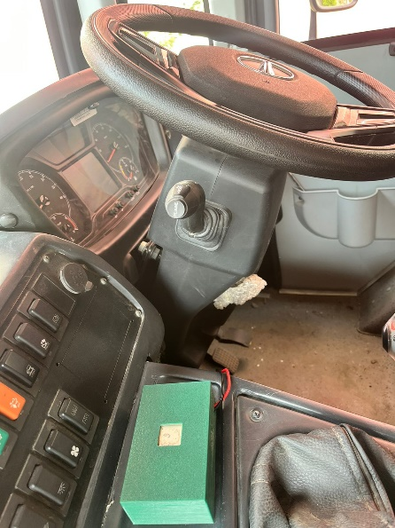
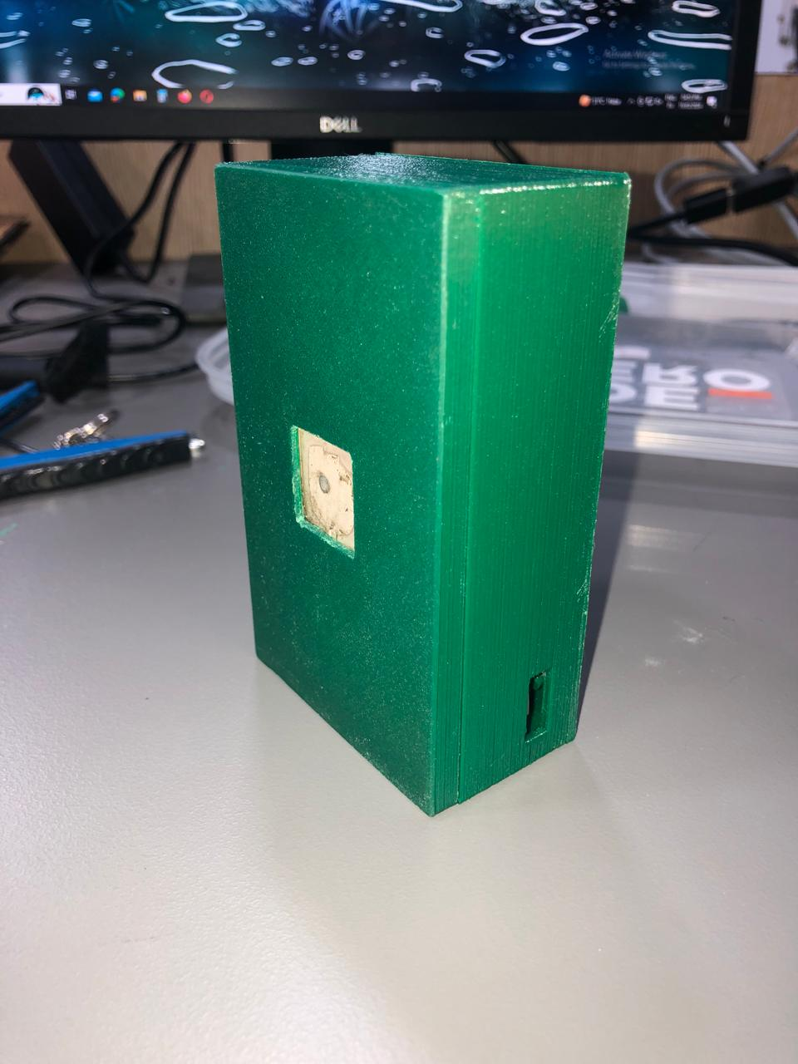
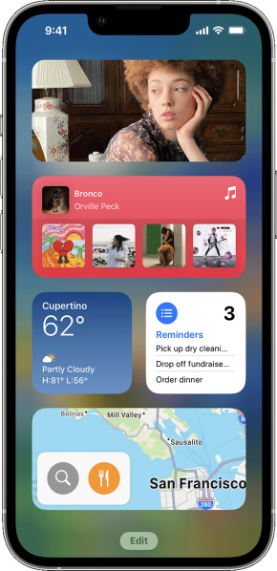
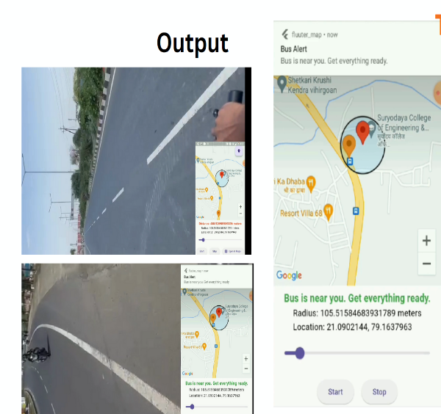

Project Objective:
Never Miss the Bus Again: Introducing Smart Bus
The wait at the bus stop is a universal experience, often filled with uncertainty and wasted time. Smart Bus, a portable device with a built-in GPS system, aims to revolutionize your public transport experience.
How it Works:
Smart Bus utilizes a geofencing algorithm, creating a virtual zone around your location. When a bus equipped with this device enters your zone, the device sends an alert to your user-friendly mobile app. This eliminates the need for constant bus stop monitoring and allows you to adjust the notification radius based on your preference.
Smart Bus – Nearby Alerts
“Smart Bus empowers you to take control of your commute. No more waiting in the unknown. Get notified, get ready, and catch your bus with ease”

Slide 2
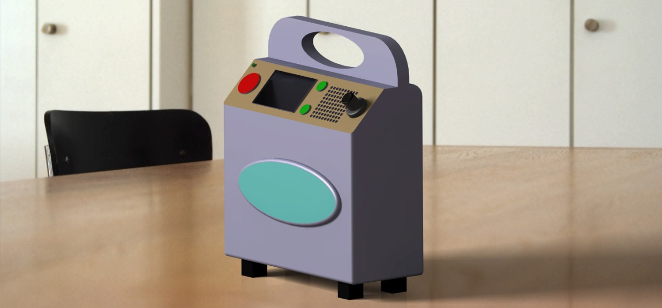
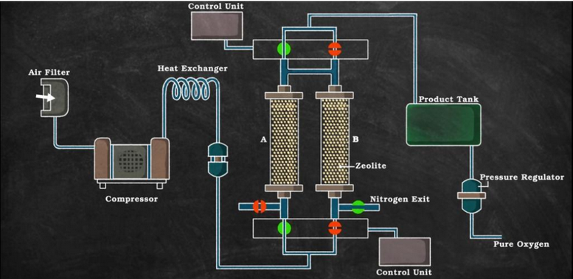
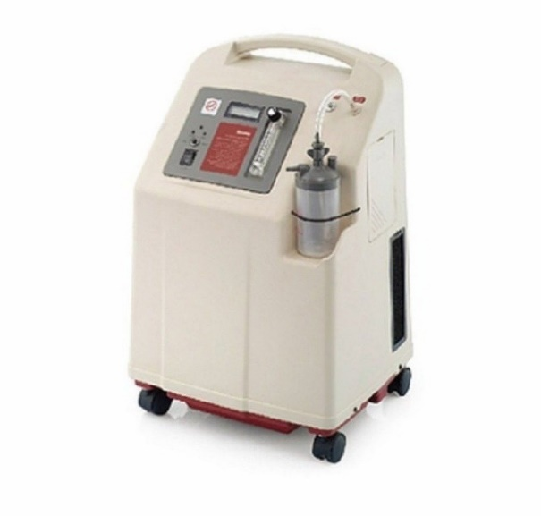
The objective of the project is to provide portable oxygen concentrator at very affordable price, so that everyone can afford this device and use it in tough situations.
The ulterior motive behind this work is to offer a relief to those who are engraved by the ongoing pandemic and to prevent any undue situation
Portable Oxygen Concentrator

Slide 3
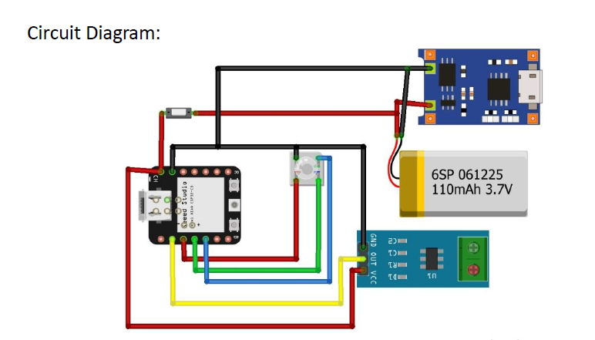
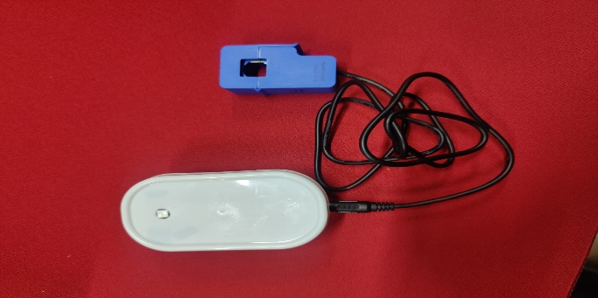
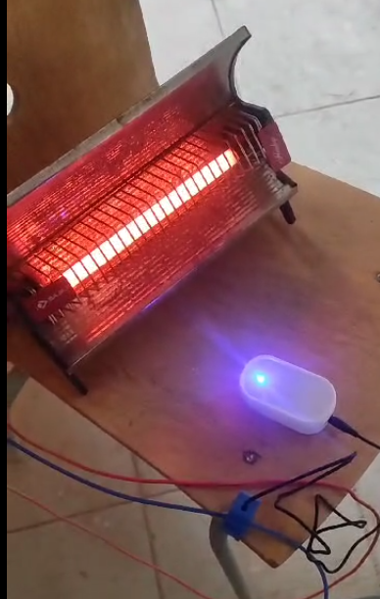
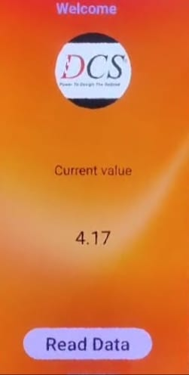
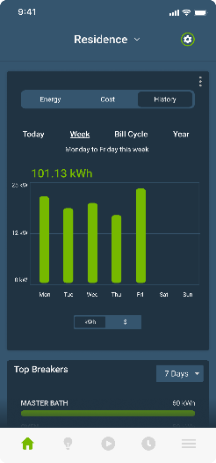
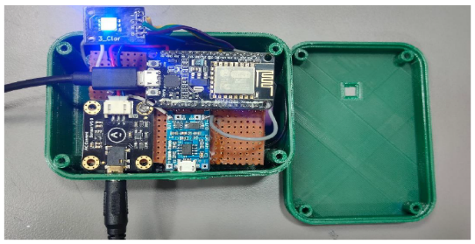
Project Objective:
The smart clamp meter is a portable device that clips around a wire to measure the current coursing through it. This lets you monitor the real-time energy consumption of any appliance in your home. It even has a detachable CT coil for easy use on different-sized wires.
How it Works:
The built-in MCU (microcontroller unit) processes the data, and the battery keeps it powered. But the real magic happens through a companion mobile app. This app lets you remotely see how much energy your appliances are using, allowing you to optimize their usage and potentially save money on your electricity bill.
Smart Clamp Meter
“A smart clamp meter clips on any wire, letting you monitor appliance energy use in real time. Its detachable CT coil fits various wires, and the app keeps you informed – all to help you save power and money.”

Slide 4
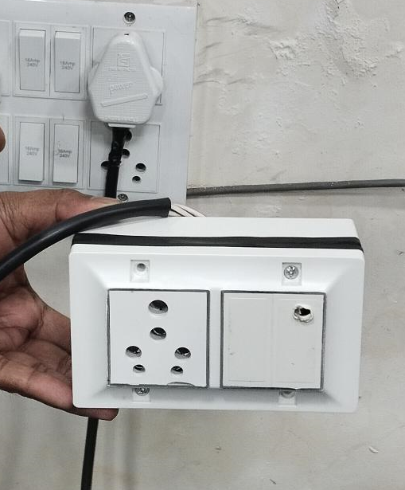
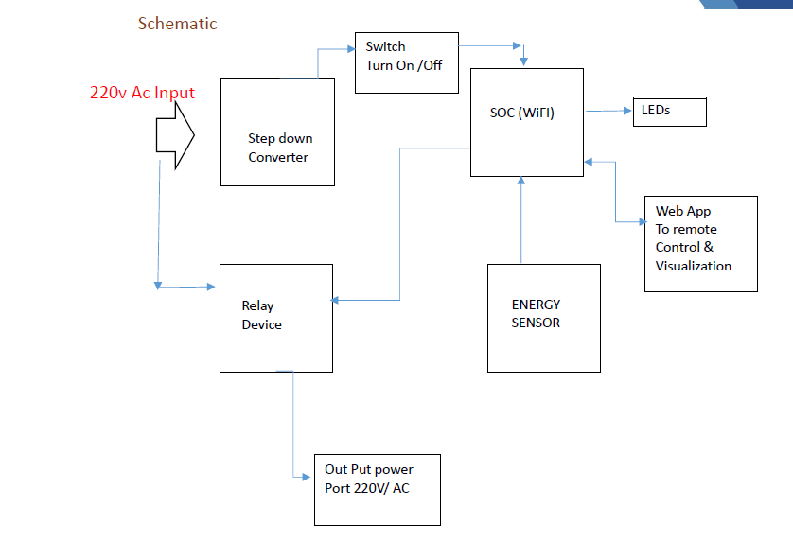
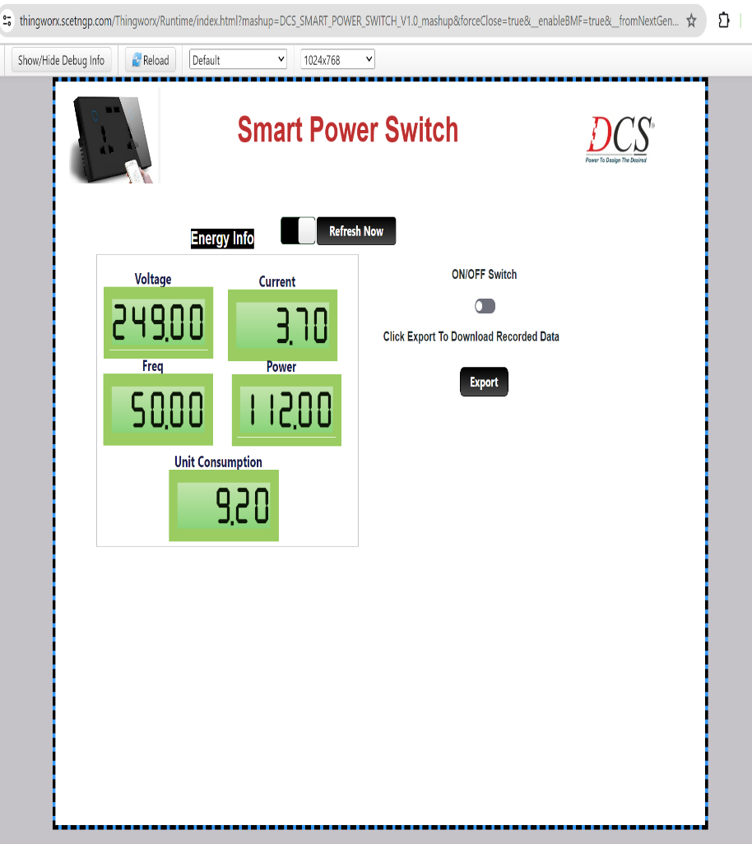
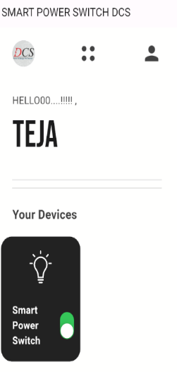
Smart Plug – 16A
Project Objective:
This portable device seamlessly integrates with your existing electrical outlets, offering a suite of features to manage your appliances and optimize energy usage.
what it offers:
Remote Control: Power electronics on or off from anywhere using a user-friendly mobile app.
Energy Monitoring: Track real-time energy consumption and gain insights into appliance efficiency.
Device Utility Tracking: Identify "phantom loads" and hidden energy drains.
IoT Cloud Connectivity: Connect seamlessly to the cloud for secure data storage and access.
Anomaly Detection: Monitor for electrical parameter fluctuations and potential safety hazards.
Smart Alerts: Receive notifications for heavy energy usage and tariff changes based on your location's electricity plans.
“The smart plug empowers you to take control of your home's energy ecosystem, promoting efficiency, savings, and peace of mind.”

Slide 5
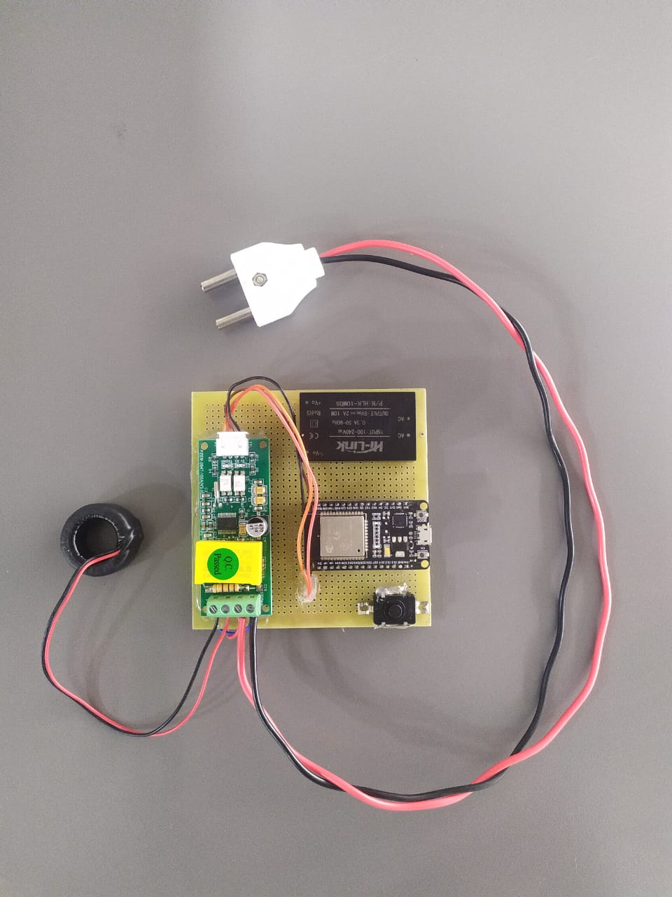
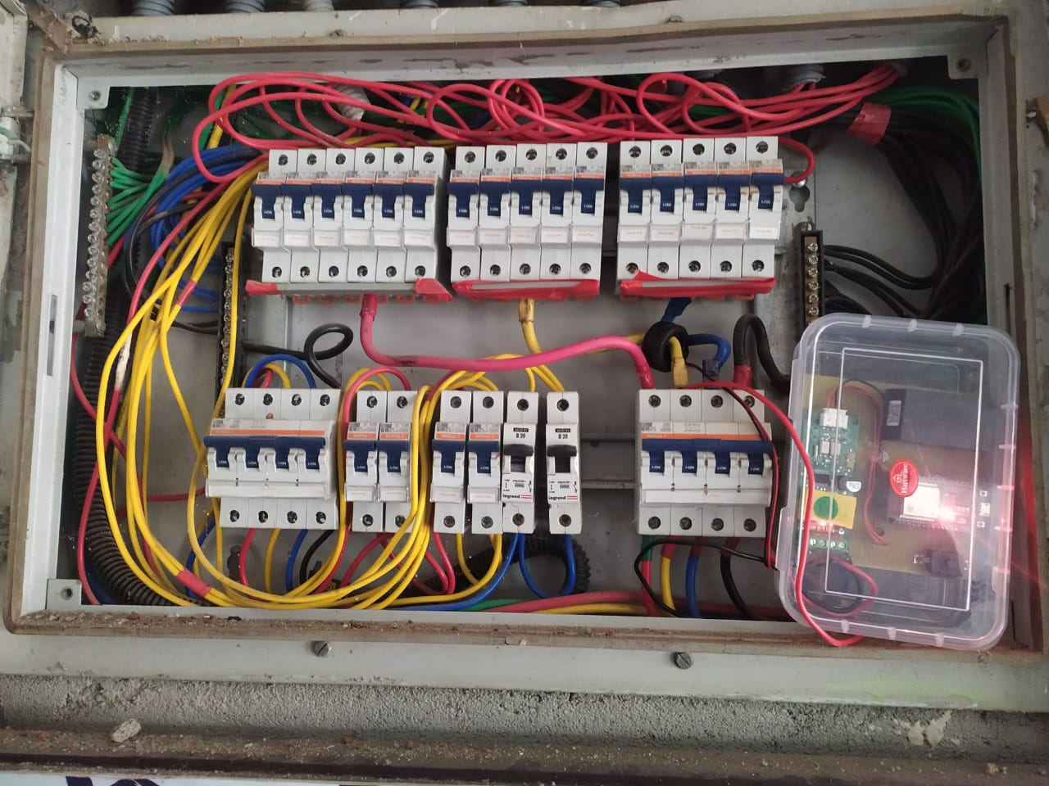
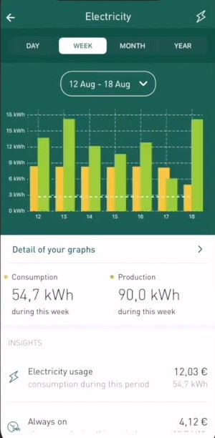
Smart Energy Meters
Project Objective:
The smart meter revolutionizes how you manage your electricity consumption. Installed at your electrical panel, this compact device tracks power usage across individual circuits, providing a clear picture of your energy landscape.
what it offers:
Remote Control: Power electronics on or off from anywhere using a user-friendly mobile app.
Energy Monitoring: Track real-time energy consumption and gain insights into appliance efficiency.
Device Utility Tracking: Identify "phantom loads" and hidden energy drains.
IoT Cloud Connectivity: Connect seamlessly to the cloud for secure data storage and access.
Anomaly Detection: Monitor for electrical parameter fluctuations and potential safety hazards.
Smart Alerts: Receive notifications for heavy energy usage and tariff changes based on your location's electricity plans.
“Unleash Energy Savings with Smart Meters. Empowering you to make informed choices and unlock significant cost savings, the smart meter is a key investment for your home, office, or commercial building”

Slide 6
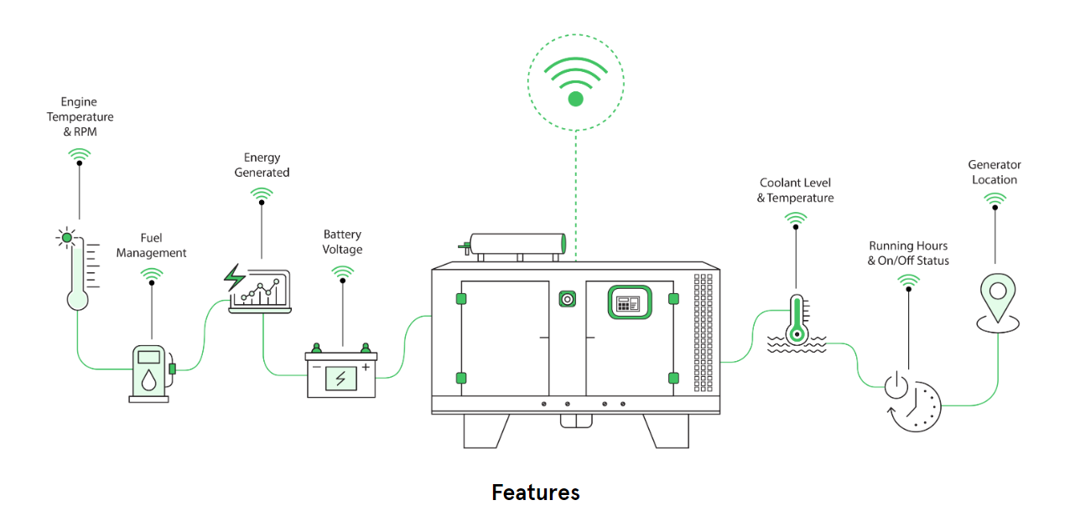
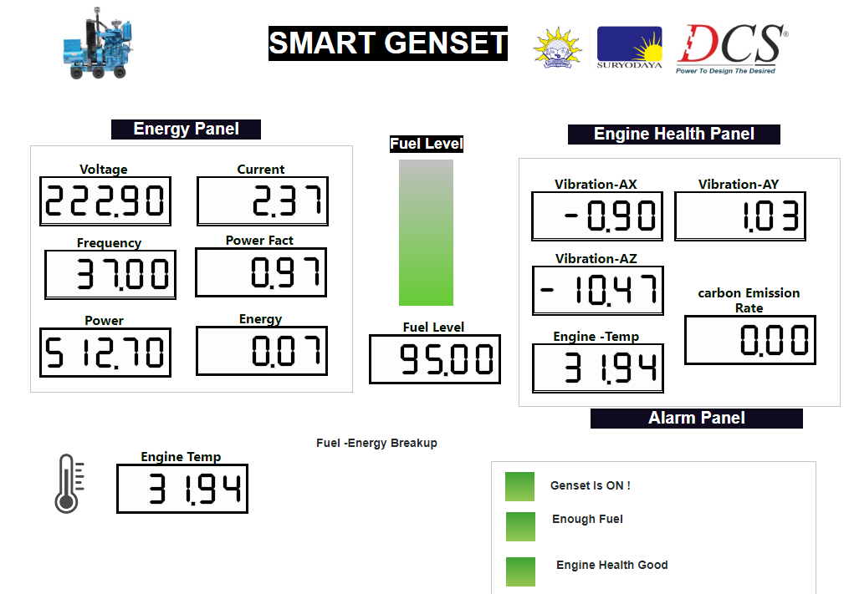
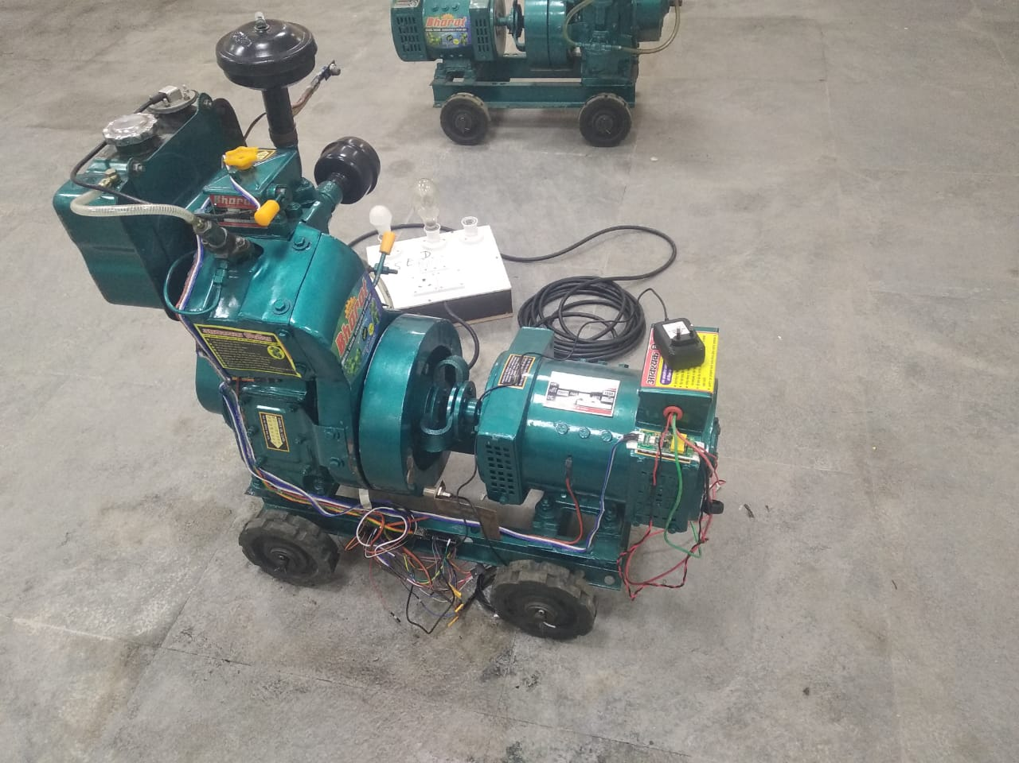
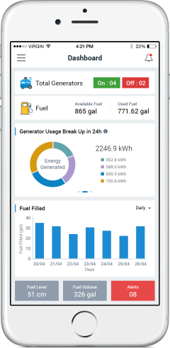
Smart Genset
Project Objective:
It leverages IoT Sensors and IoT Cloud Platform technology to provide real-time insights and improve generator management
what it offers:
Essential Monitoring: Keep tabs on engine and coolant temperatures, running hours, and battery voltage for optimal performance.
Fuel Efficiency: Monitor fuel levels in real-time and receive alerts for leaks, preventing theft and optimizing fuel usage.
Predictive Maintenance: Identify potential mechanical issues before they cause downtime, allowing for proactive maintenance.
Remote Management: Control and monitor your generator remotely, eliminating the need for constant physical checks.
Interactive Dashboards: Get a clear picture of your generator's health through user-friendly dashboards displaying real-time data.
Peace of Mind: With features like fuel theft alerts and remote management, you have greater control and security over your power source.
“Smart Genset, Power with Intelligence. Drive down your operational costs with a genset monitoring system”

Slide 7
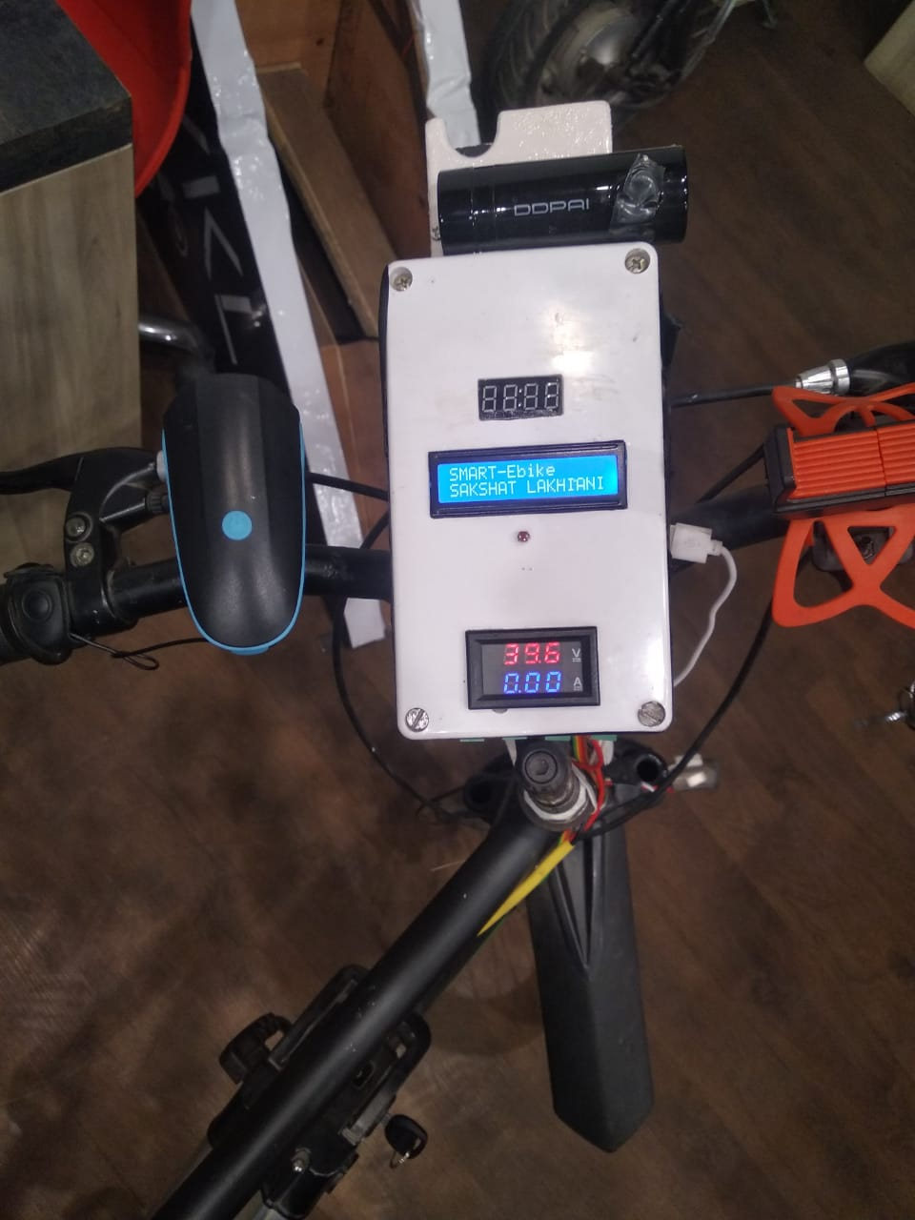
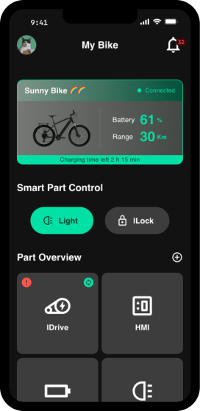
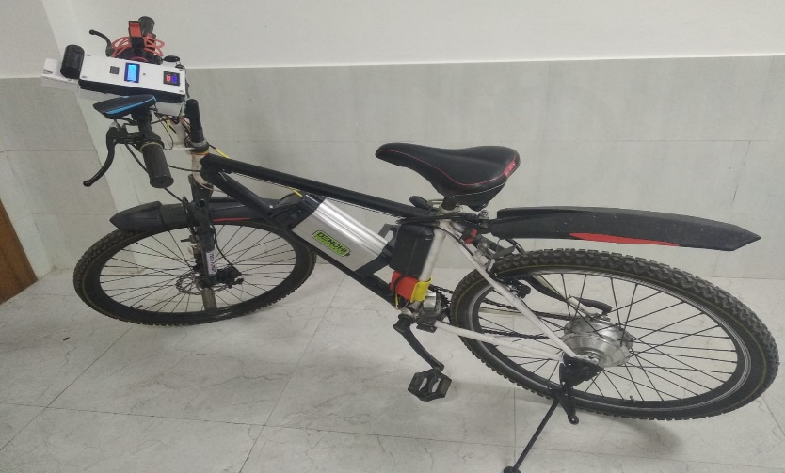
Smart E-Bikes
Project Objective:
PBS -Public Bike Sharing with the introduction of smart electric bikes system. These smart e-bikes offer a convenient, secure, and sustainable way to get around town.
what it offers:
Convenience: Unlock and lock your bike seamlessly with an RFID card. No more fumbling with keys or combinations.
Safety First: A built-in camera provides peace of mind, recording your ride and deterring theft.
Eco-Friendly Power: Enjoy a smooth, electric ride while reducing your carbon footprint.
Responsible Usage: Limited access based on card recharge encourages fair usage and keeps bikes available for everyone.
“Smart Genset, Power with Intelligence. Drive down your operational costs with a genset monitoring system”

Slide 8
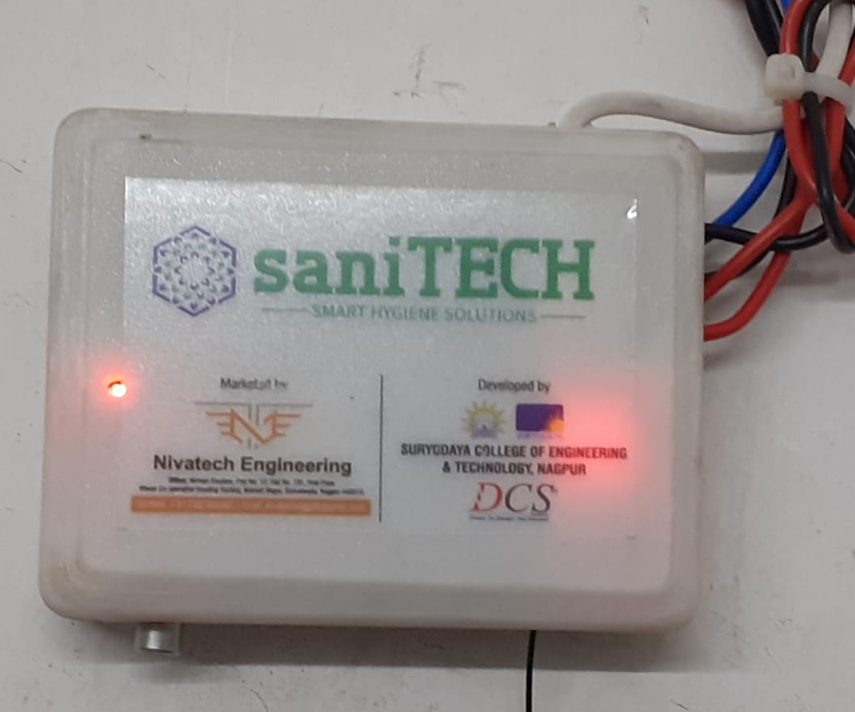
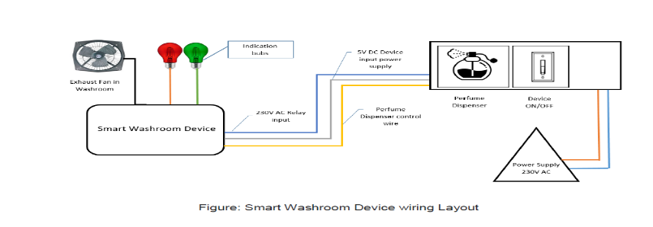
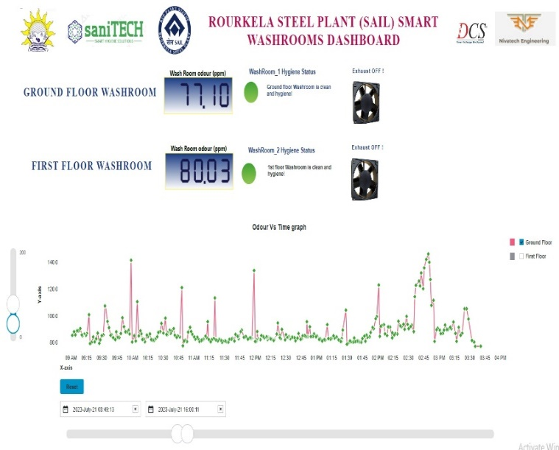
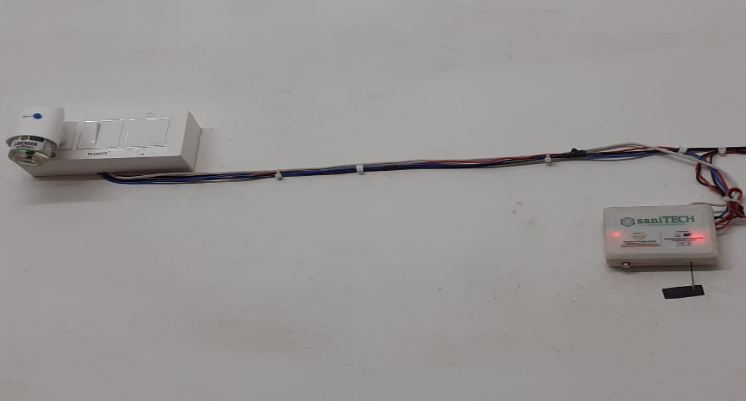
Smart Restroom Device
Project Objective:
The Internet of Things (IoT) is making its way even to the restroom, with innovative smart restroom devices designed to improve hygiene and user experience. These devices leverage sensors and cloud connectivity to automate tasks and optimize cleaning routines.
Odour Detection and Response: The sensor detects unpleasant odours and transmits data to the cloud. If deemed unhealthy, the system automatically activates the exhaust fan. In extreme cases, a perfume dispenser is triggered to freshen the air.
Real-Time Monitoring: A centralized dashboard provides easy monitoring and control of all washroom devices. This allows for:
Optimized Cleaning Schedules: Cleaning can be triggered based on real-time usage data, rather than fixed schedules, ensuring timely cleaning.
"Proudly crafted in India, our smart restroom device is a breath of fresh air for the Swachh Bharat Abhiyan. By promoting hygiene and efficiency, we're committed to cleaner workplaces and a healthier nation."

Slide 9
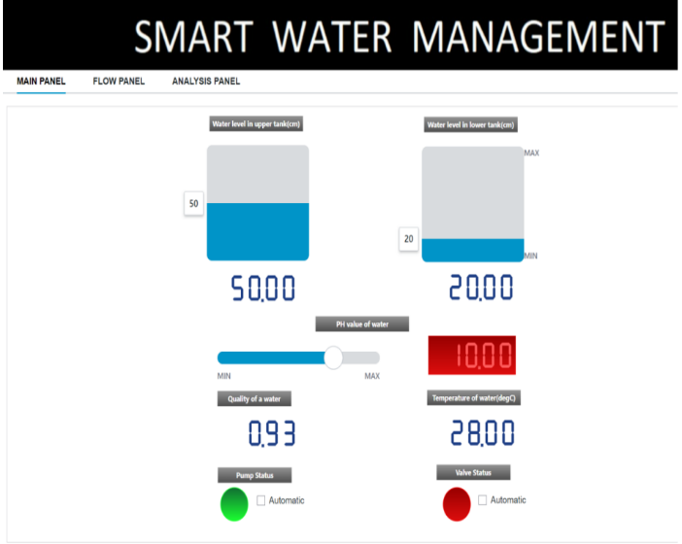
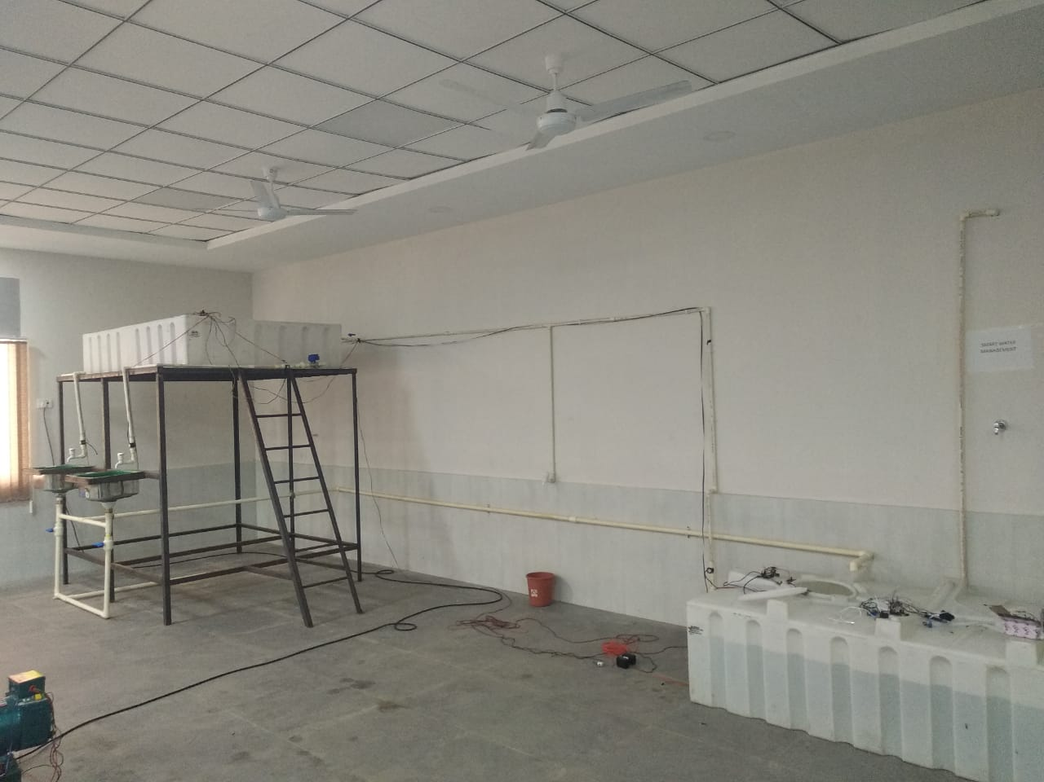
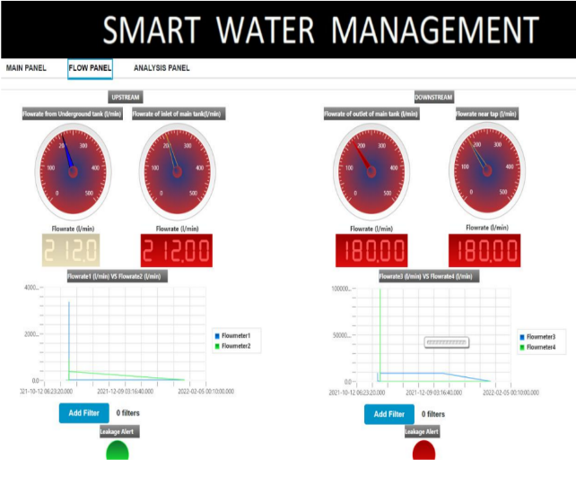
SMART WATER MANAGEMENT SYSTEM
Project Objective:
The system aims to address various aspects of water management, including automatic water pump control, leakage detection and automatic valve control, water quality monitoring, and real-time data analysis with manual control.
How it works : It works by integrating various sensors, actuators, and control mechanisms to enable real-time monitoring and automated control of water-related processes. For automatic water pump control feature utilizes sensors to monitor water levels in tanks or reservoirs and automatically activate or deactivate the water pumps based on the water level thresholds. The leakage detection and automatic valve control component employs sensors to detect leaks in the water distribution system and triggers automatic valve control to isolate the affected area, preventing water loss and damage.
An innovative solution designed to revolutionize the way water resources are monitored, controlled, and conserved.
By integrating advanced technologies.

Slide 10
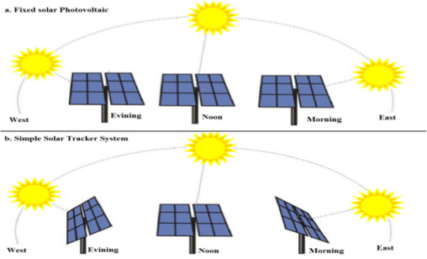
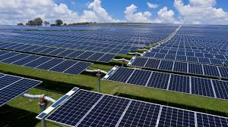
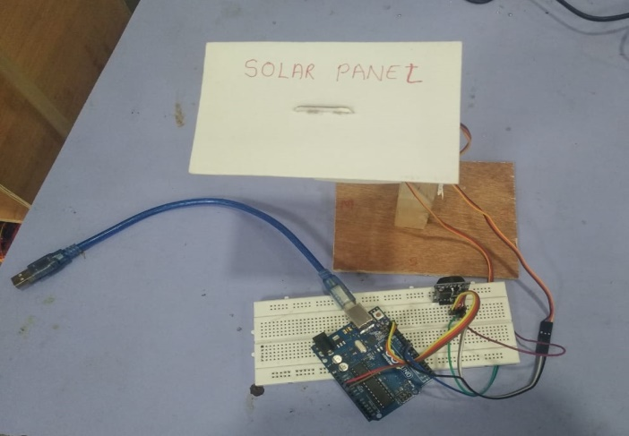
SMART SOLAR TRAKING SYSTEM
Project Objective:
Develop an advanced system capable of accurately tracking the position of the sun based on the installation location, adjusting the orientation of solar panels to maximize energy capture, ensuring regular cleaning of the solar panels, and providing remote monitoring of the voltage and current generated by the solar panel array.
How it works : It works by utilizing a combination of sensors, actuators, and control mechanisms to continuously monitor the position of the sun relative to the solar panel array. System incorporates mechanisms for periodic cleaning of the solar panels to maintain optimal performance. Furthermore, it enables remote monitoring of the voltage and current output of the solar panels, providing real-time data on energy generation and system performance.
Aim is to enhance the efficiency and output of solar energy systems by ensuring optimal solar panel orientation, cleanliness, and performance monitoring, thereby contributing to sustainable and reliable renewable energy generation..

Slide 11
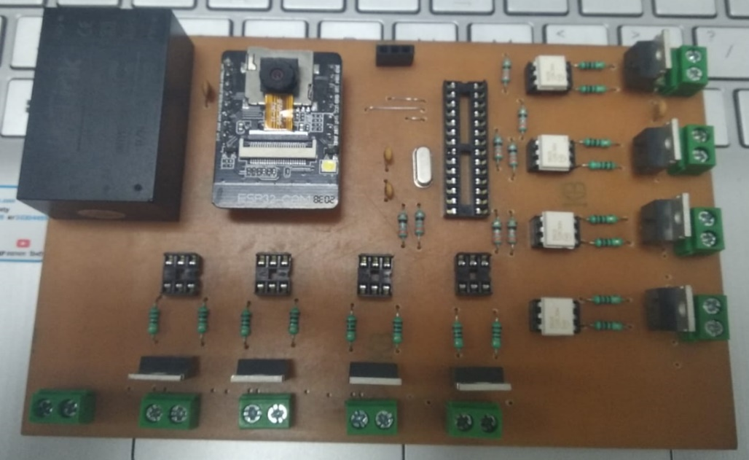
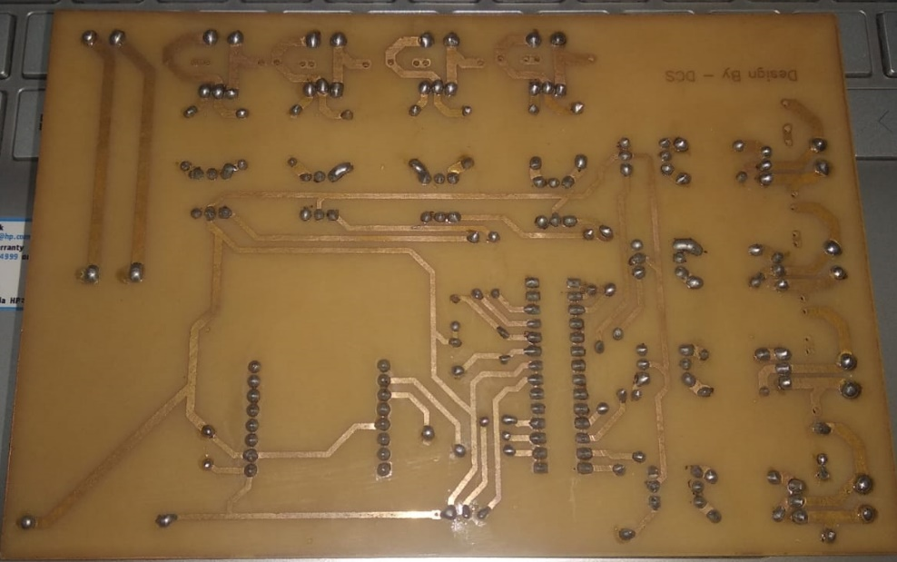
SMART HOME AUTOMATION USING IOT
Project Objective:
The objective of the project is to create a cutting-edge system that enables the control of home appliances through voice commands and a web application, leveraging the power of the Internet of Things (IoT) technology.
How it works : This innovative system works by integrating IoT-enabled devices with home appliances, allowing users to issue voice commands for controlling various devices such as lights, thermostats, and entertainment systems. Additionally, the system provides a web application interface, enabling users to remotely manage and monitor their home appliances from any location with internet access.
By harnessing IoT technology, the SMART HOME AUTOMATION system facilitates seamless and convenient control of home appliances, enhancing user comfort, energy efficiency, and overall home management.

Slide 12

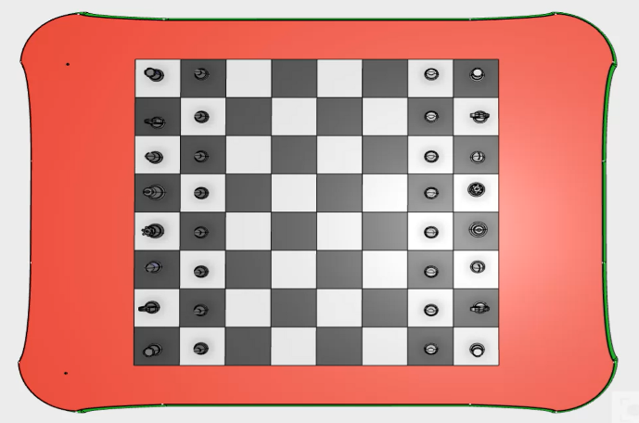
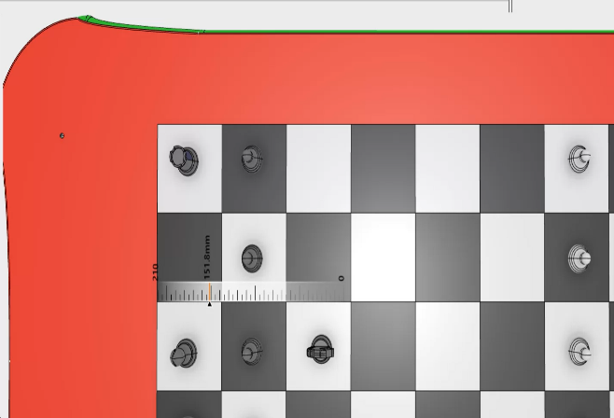
SMART CHESS BOARD PROJECT
Project Objective:
The objective of the "SMART CHESS BOARD PROJECT" is to create a chess board that enables human vs. computer gameplay, featuring automatic movement of chess pieces for the computer player.
How it works : The project works by utilizing an XY table with an electromagnet mounted on the moving trolley. When the electromagnet is positioned below a chess piece, a magnetic contact is established through the chessboard, allowing the chess piece to move along with the trolley as it moves, enabling automatic movement of the computer player's chess pieces.
Aim to provide an innovative chess playing experience by enabling human vs. computer gameplay with automatic movement of chess pieces for the computer player, enhancing the overall gaming experience for enthusiasts of the game.

Slide 13
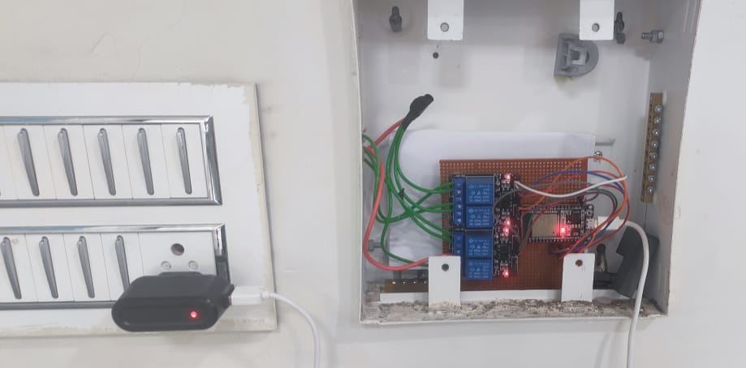
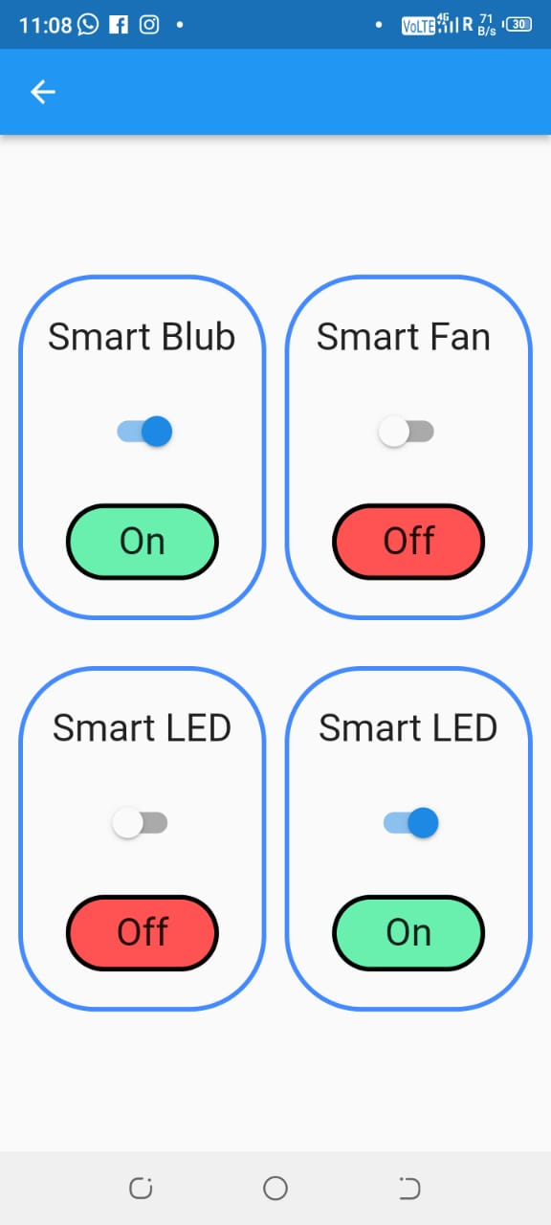
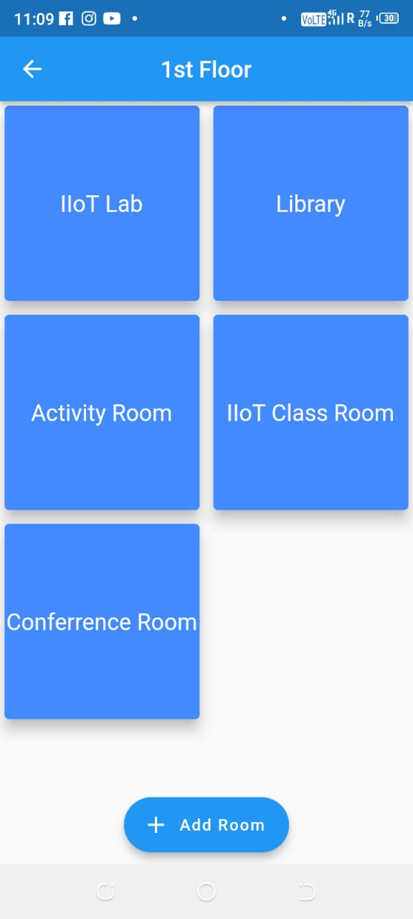
SMART LAB AUTOMATION
Project Objective:
The objective of the SMART LAB AUTOMATION project is to introduce an automated system for controlling laboratory appliances through the utilization of the Node MCU WiFi Module.
How it works : This innovative system works by leveraging the Node MCU WiFi Module to enable wireless communication and control of lab appliances. The mobile application, developed using Flutter, serves as the primary interface for users to remotely manage and monitor the functioning of laboratory equipment.
Through this integration, the SMART LAB AUTOMATION system enhances operational efficiency, convenience, and precision in laboratory settings.

Slide 14
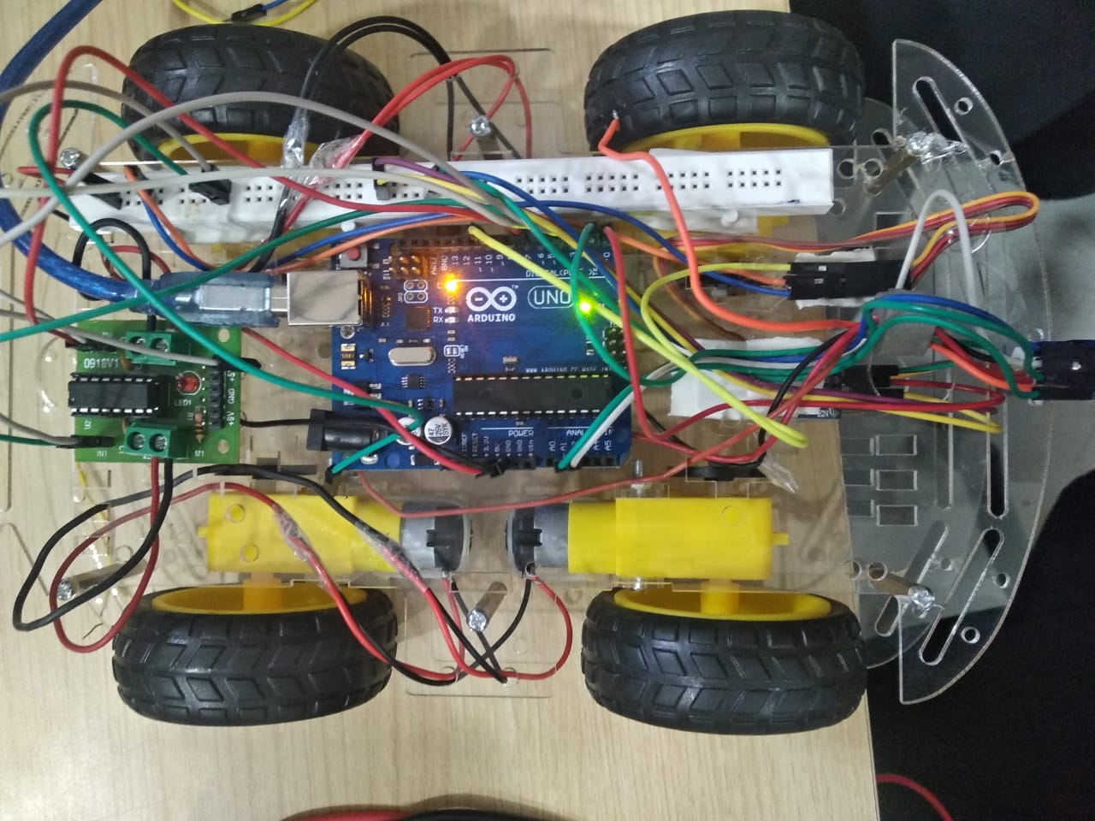
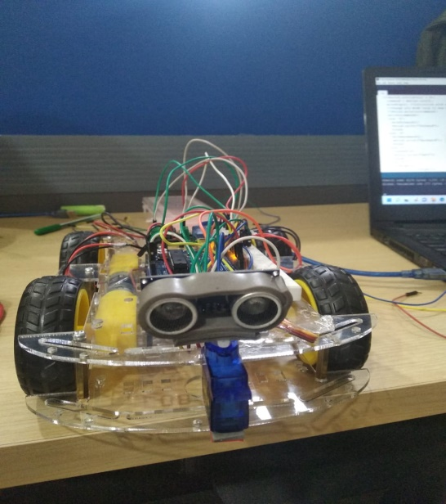
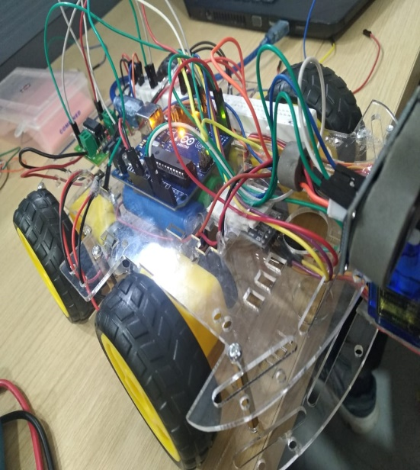
OBSTACLE AVOIDING & BLUETOOTH
CONTROLLED CAR
Project Objective:
The objective of the "OBSTACLE AVOIDING & BLUETOOTH CONTROLLED CAR" project is to create a robotic car with the capability to detect and avoid obstacles by utilizing an ultrasonic sensor and Arduino technology. Additionally, the project aims to enable complete control of the car through a mobile device using a Bluetooth module.
How it works : The project works by integrating an ultrasonic sensor into the robotic car to detect obstacles within its vicinity. Upon detecting an obstacle, the car autonomously alters its path to avoid the obstruction. Furthermore, the incorporation of a Bluetooth module allows users to control the car's movements and functions wirelessly via a mobile device, enhancing user interaction and operational flexibility.
project combines advanced sensor technology and wireless communication to develop a versatile robotic car capable of autonomously navigating its environment while also being remotely controlled through a mobile device.

Slide 15
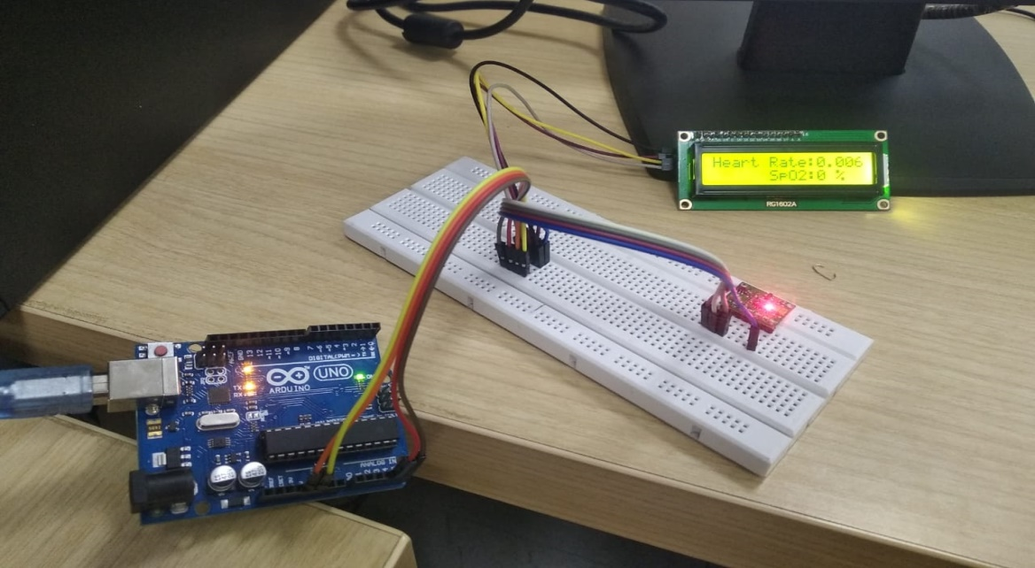
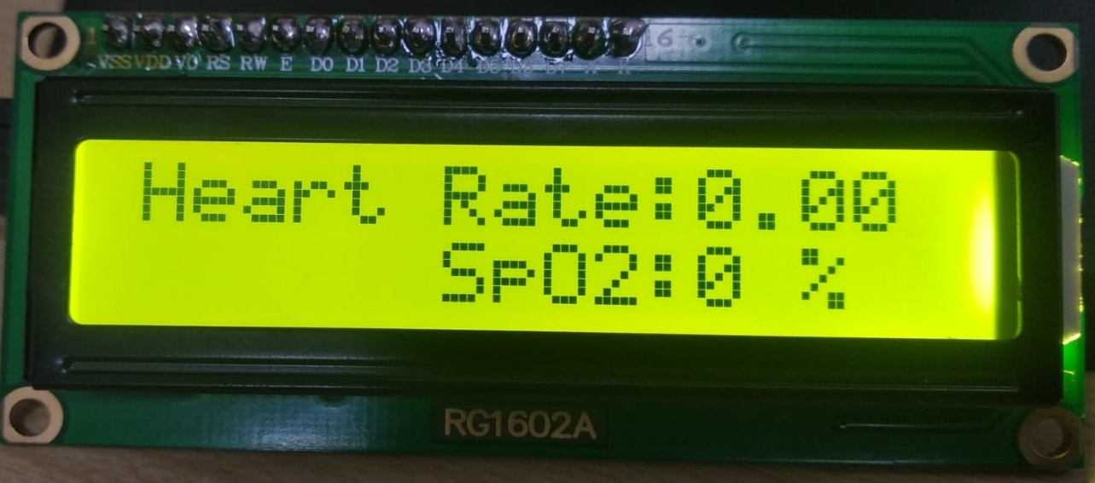
PULSE OXIMETER
Project Objective:
The objective of the "PULSE OXIMETER" project is to develop a portable device capable of measuring blood pressure and oxygen concentration in the blood (SpO2) while ensuring its user-friendliness for local communities.
How it works : The project works by integrating technology to accurately measure blood pressure and SpO2 levels, providing vital health information to users. Additionally, the emphasis on portability aims to make the device convenient and accessible for use in various settings. Furthermore, efforts to ensure the device is user-friendly and understandable by local communities are intended to facilitate widespread adoption and usage.
The "PULSE OXIMETER" project seeks to create a portable and user-friendly device for measuring blood pressure and SpO2 levels, with the goal of providing valuable health monitoring capabilities to local communities.

Slide 16
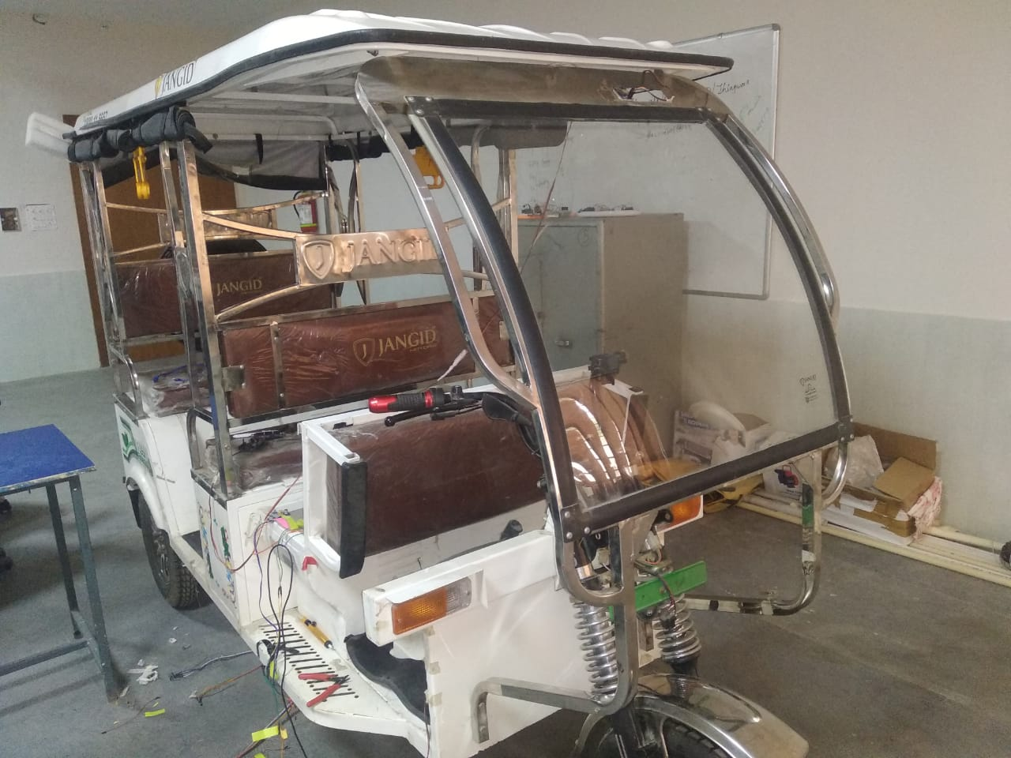

SMART ELECTRIC VEHICLE
Project Objective:
The objective is to develop an advanced system for electric vehicles that encompasses power consumption monitoring, smart vehicle location monitoring, battery health monitoring, a smart RFID unlock system for enhanced security, and predictive analysis for vehicle health using sensor data from the engine.
How it works : The project works by integrating a range of technologies and sensors to monitor and analyze various aspects of electric vehicle performance. This includes real-time monitoring of power consumption, location tracking, and battery health status. Additionally, the implementation of a smart RFID unlock system enhances vehicle security and access control.
This project aims to enhance the functionality, security, and maintenance of electric vehicles through the integration of advanced monitoring and analysis capabilities, ultimately contributing to the advancement of electric vehicle technology.

Slide 17



SMART DISC BRAKE REPLACEMENT SYSTEM
Project Objective:
The objective of the project is to develop a system that monitors the health of brake discs, enhances the braking process using embedded design, provides safety against collisions to prevent accidents, and minimizes fuel consumption by preventing unnecessary pressure on the brake pads.
How it works : The project works by integrating sensors and embedded design to monitor the health of brake discs, ensuring that they are in optimal condition for safe and efficient braking. The system aims to improve the braking process by utilizing embedded design technology to make it more comfortable and responsive. Safety features are incorporated to provide protection against collisions, ultimately reducing the risk of accidents.
The project aims to enhance vehicle safety, braking performance, and fuel efficiency through the integration of smart monitoring, embedded design, and safety features within the braking system.

Slide 18

SMART THIEF DETECTION SYSTEM
Project Objective:
The objective of the "SMART THIEF DETECTION SYSTEM" project is to create a comprehensive security solution that utilizes smart area monitoring using PIR (Passive Infrared) sensors, provides intruder alerts to the owner upon detection, offers enhanced security options for secured areas, and incorporates smart human detection and data analysis capabilities.
How it works : The project works by implementing PIR sensors for smart area monitoring, enabling the system to detect human presence and movement within the monitored area. Upon detecting an intruder, the system promptly alerts the owner, providing real-time notifications to mitigate security threats. Additionally, the project aims to offer advanced security options for safeguarding secured areas, enhancing overall protection against theft and unauthorized access.
Project aims to enhance security through the utilization of smart monitoring, intruder alerts, advanced security options, and intelligent human detection and data analysis.

Slide 19

SMART PALLET JACK
Project Objective:
The objective is to develop a system that monitors real-time weight on the pallet jack, detects overloads in real time with an alarm system, incorporates a display unit for continuous weight reading, and identifies incorrect placement of objects on the pallet jack.
How it works : The project works by integrating sensors to monitor the real-time weight on the pallet jack, providing accurate and up-to-date information regarding the load being carried. In the event of an overload, the system promptly detects it and triggers an alarm to alert operators. Additionally, a display unit is incorporated to provide continuous weight readings, enhancing operational visibility and control. Furthermore, the system is designed to identify and alert users to instances of incorrect object placement on the pallet jack, ensuring safe and proper handling of loads.
project aims to enhance operational safety and efficiency by providing real-time weight monitoring, overload detection, continuous weight readings, and object placement detection, ultimately contributing to improved handling and management of pallet jack operations.

Slide 20


SMART LIGHT AUTOMATION AND TEMPERATURE MONITORING
Project Objective:
To implement a system that reduces electricity consumption, saves costs, and enhances convenience. The project achieves this by automatically controlling the lighting using PIR (Passive Infrared) sensors, as well as monitoring the temperature and humidity of the room, displaying the data over an LED display.
How it works : The project works by integrating PIR sensors to automate the switching on and off of lights based on the presence of individuals in the room, thereby reducing unnecessary energy consumption. Additionally, the system monitors the temperature and humidity of the room, providing real-time data displayed over an LED display. This monitoring capability allows for better environmental control and energy management within the space.
Project aims to reduce electricity consumption, enhance convenience, and improve environmental control through the integration of automated lighting control.

Slide 21


SMART FACE
DETECTION
SYSTEM
Project Objective:
The objective of the "SMART FACE DETECTION SYSTEM" project is to enhance security measures, protect businesses against theft, reduce touch points, and aid in finding missing individuals.
How it works :
The project works by utilizing advanced facial recognition technology to strengthen security measures, identify unauthorized individuals, and minimize the need for physical touch points for access control. Additionally, the system can be employed to assist in locating missing persons through the analysis and recognition of facial data.
This project aims to bolster security, streamline access control, and contribute to public safety through the implementation of advanced facial recognition capabilities.

Slide 22


AI BASED COMPUTER CONTROLLER SYSTEM
Project Objective:
Objective of the project is to develop a system that enables comfortable and convenient control of devices, particularly benefiting physically impaired individuals in operating room devices. The system is designed to facilitate short-distance communication and can be utilized in home theater systems, offering a simple circuitry that does not require special hardware.
How it works :
Implementing AI-based technology to provide intuitive and accessible control of devices, catering to the needs of users, including those with physical impairments. Additionally, the system's design allows for seamless integration into home theater setups, enabling straightforward and efficient communication within a short distance.
It enhance device control, improve accessibility, and provide convenience through the utilization of AI technology and simple circuitry, benefiting a wide range of users, including those with physical impairments.

Slide 23

MOUSE CONTROL AND BASIC AUTOMATION
Project Objective:
Project objective is to implement basic automation for specific tasks in Windows, leveraging two ultrasonic sensors and an Arduino development board. The project aims to enable basic control of screen mouse operations and automate certain tasks within the Windows operating system.
How it works :
By integrating two ultrasonic sensors and an Arduino development board to facilitate the control of screen mouse operations and implement basic automation for designated tasks in the Windows environment. This setup allows for the automation of specific actions and the control of mouse operations, contributing to improved efficiency and user experience within the Windows operating system.
It enable basic automation of tasks in Windows using two ultrasonic sensors and an Arduino development board. Ultimately it enhancing user efficiency and experience.

Slide 24

NOISE DETECTION SYSTEM
Project Objective:
The objective of the "NOISE DETECTION SYSTEM" project is to implement a system for detecting and monitoring noise levels, specifically tailored for library environments.
How it works :
The project works by deploying sound sensors in various locations within a library or other relevant premises to continuously monitor and detect noise levels, thereby ensuring a conducive and quiet environment for studying and reading.
project focuses on providing a solution for detecting and monitoring noise levels in library settings, utilizing sound sensors strategically placed throughout the premises to maintain a peaceful and suitable environment for concentration and study.

Slide 25

KEYPAD DOOR LOCK SYSTEM
Project Objective:
The objective of the "KEYPAD DOOR LOCK SYSTEM" project is to develop a secure door locking mechanism based on a keypad entry system, suitable for applications in home security and locker systems.
How it works :
The project works by integrating a solenoid lock with a keypad entry system to provide secure access control for doors. Users can input a predefined code via the keypad to unlock the door, providing a reliable and convenient security solution.
The "KEYPAD DOOR LOCK SYSTEM" project focuses on creating a secure door locking system using a keypad and solenoid lock, offering an effective and practical solution for enhancing home security and providing secure access control for locker systems.

Slide 26




RAIN LEVEL and WEATHER MONITORING SYSTEM
Project Objective:
The objective of the "RAIN LEVEL AND WEATHER MONITORING SYSTEM" project is to detect rain levels and monitor weather conditions, including measuring the volume of rain and monitoring the temperature and humidity of the surrounding environment.
How it works :
The project works by integrating sensors to detect and measure rain levels, providing data on the volume of rain. Additionally, it monitors the temperature and humidity of the surrounding area, offering comprehensive weather data for analysis and monitoring.
Detect rain levels and monitoring weather conditions, including temperature and humidity, thereby facilitating informed decision-making and enhancing environmental monitoring capabilities.

Slide 27

APPLIANCE CONTROL
USING TELEGRAM
Project Objective:
The objective of the "APPLIANCE CONTROL USING TELEGRAM" project is to enable the remote control of appliances through the use of the Telegram messaging platform.
How it works :
The project works by integrating a Telegram bot that allows users to send ON/OFF messages to control appliances remotely. Upon receiving the command, the system activates or deactivates the designated appliance, providing convenient and accessible control from a remote location.
The project facilitates the remote control of appliances through the Telegram platform, offering users the ability to send ON/OFF commands via a Telegram bot for convenient and accessible appliance control from a distance.

Slide 28


SMART HAND SANITIZATION MACHINE
Project Objective:
The objective of project is to develop a device that dispenses a controlled amount of sanitizer, promotes hand sanitization by reminding individuals to sanitize before accessing a certain area, and contributes to reducing the spread of infectious diseases.
How it works :
by integrating a device that dispenses a controlled amount of sanitizer, promoting regular hand sanitization. Additionally, the system includes a reminder mechanism to prompt individuals to sanitize before accessing a particular area, thereby encouraging hygienic practices and reducing the transmission of infectious diseases.
Promote regular hand sanitization by dispensing controlled amounts of sanitizer and reminding individuals to sanitize before accessing specific areas, ultimately contributing to improved hygiene.

Slide 29


GESTURE CONTROLLED LIGHT
AUTOMATON
Project Objective:
Project objective is to design a home automation system that can be controlled using gestures, providing a hands-free and intuitive method for users to interact with and control appliances.
How it works :
by integrating a camera module to capture and interpret user gestures, allowing users to select and control appliances such as lights and fans through specific hand movements. Users can swipe through devices by moving a finger left or right to select, and switch the appliance ON or OFF by moving a finger upward or downward, offering a convenient and innovative method for home automation.
A hands-free home automation solution, enabling users to control appliances using gestures captured and interpreted by a camera module, offering a seamless and interactive experience for controlling lights and fans.

Slide 30

INTRUDER ALARM SYSTEM
Project Objective:
The objective of the "INTRUDER ALARM SYSTEM" project is to focus on farm monitoring and security, utilizing wireless intrusion detectors to detect the presence of humans, animals, or birds on the farm land and raise an alarm to deter intruders.
How it works :
The project works by employing wireless intrusion detectors as sensors to detect the presence of humans, animals, or birds through visualization from cameras. When contact is made, the circuit is grounded, generating an input signal to indicate the presence of intruders. Subsequently, the system activates an alarm to deter intruders from the farm premises.
Designed to enhance farm security by utilizing wireless intrusion detectors to detect and raise alarms in response to the presence of intruders, ultimately contributing to improved monitoring and protection of farm premises.

